Slide 1


Business Problem 2 – Unemployment Trend in India

Slide 2

Business Problem:
You have been hired by the Government of India as a Tableau Developer.
Your first assignment is to deliver an analysis with area chart which help in showing the unemployment across different age groups. Also help them to navigate the chart using different filter.
What we will learn today
Line Chart
Discrete vs Continuous Date Dimension
Relation between Granularity and Aggregation
Area Chart
Difference between Area and Line Chart
Filters in Tableau
Normal Filters
How Filters behave when Dimensions, Measures and Date will be the part of Filters

Slide 3
Granularity vs. Aggregation
Customer | City | State | Country | Sales
Rahul | Mumbai | Maharashtra | India | 150
Rohit | Pune | Maharashtra | India | 100
Sachin | Gurgaon | Haryana | India | 125
Swati | Gurgaon | Haryana | India | 155
Surbhi | Delhi | Delhi | India | 170
Deepti | Delhi | Delhi | India | 130
Shivani | Delhi | Delhi | India | 120
Granularity Increases
Aggregation Decreases

Slide 4
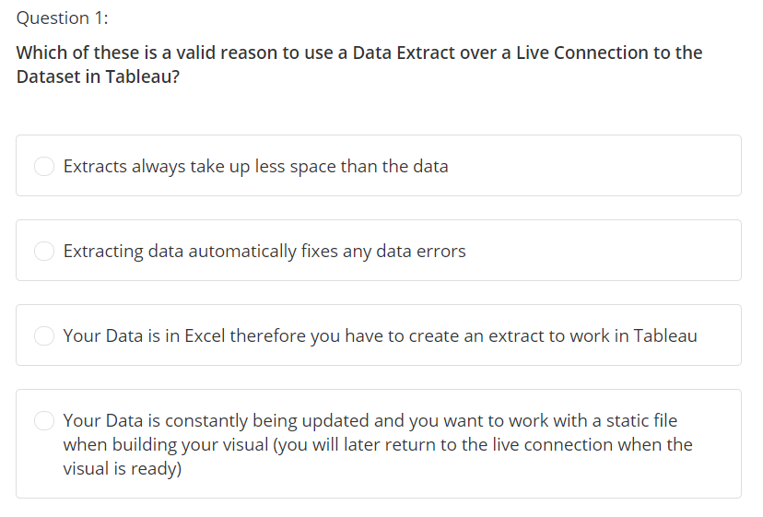

Slide 5
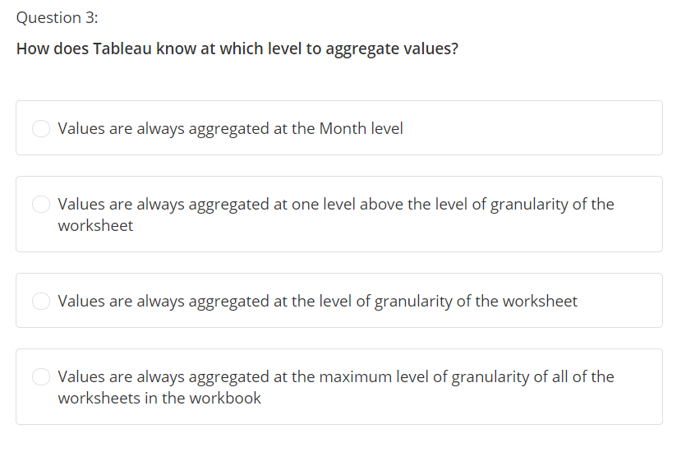

Slide 6
